Slide 1
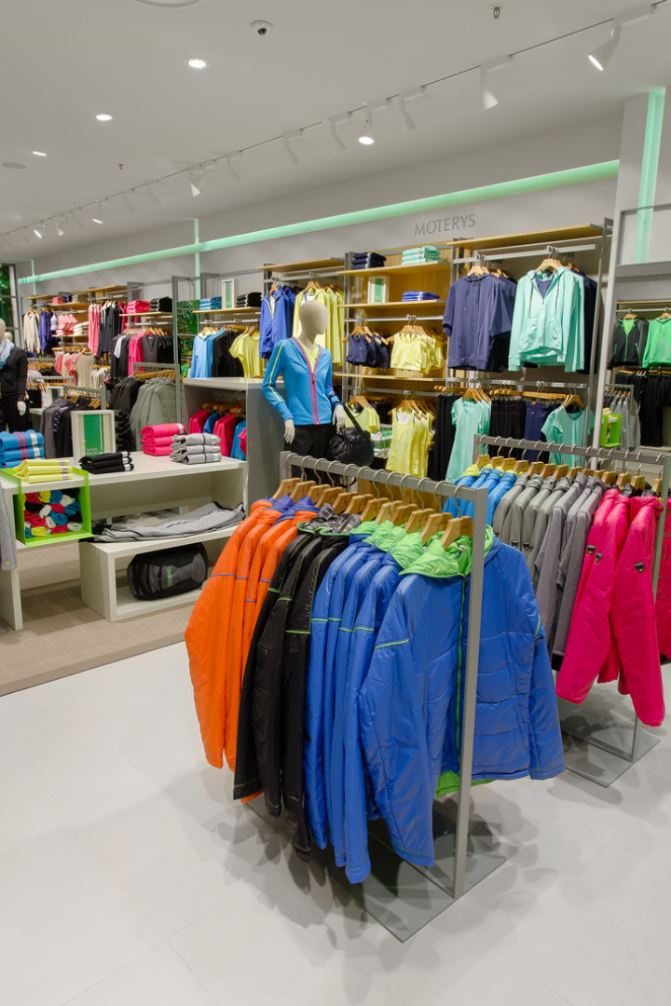

Building a Retail Analysis Presentation
With the right insights, retailers can boost sales, optimize inventory, and create a customized customer experience. This project aims to offer a comprehensive analysis to help retail stakeholders make data-driven decisions, targeting everything from customer preferences to product line revenue.
by Aditya Swarnakar

Slide 2
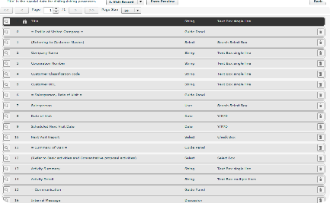


Tracking Sales by Product Category
Monthly Revenue by Product Category
Yearly Order Volume Trend
Sales Contribution by Top Customers Vs. Others
Understanding how monthly revenue changes across different product categories. Use this data to determine which product categories deserve more attention in marketing and which may be underpriced.
Track how customer order volume changes over the past year. Look for trends in seasonality or changes in customer behaviors and adjust sales efforts accordingly.
Determining how much of your overall sales come from top customers versus others. Identify which customer segments are contributing the most and which should be targeted for increased attention.

Slide 3
Product Sales Across Product Lines
1
Product Line Distribution
Shown how product sales are distributed across different product lines.
Top-selling Products by Product Category
2
Shown which products are the top-sellers within each unique product category.
3
Product Performance over Time
Tracking how product sales, pricing, and stock change for each unique product category over time. Use this data to identify patterns or adjust pricing strategies as needed.

Slide 4

Tracking Inventory and Profitability
1
Profitability by Product
2
Inventory Management
Comparison of the profitability of different products. Adjust inventory management strategies accordingly.
Monitoring of inventory levels and track how they change over time.
3
Data-Driven Inventory Optimization
Used data analysis to make informed decisions about when to order, how much to order, and when to reorder.

Slide 5
Sales Employee Performance and Reporting
Employee Reports
Employee Productivity and Sales Performance
Multi-Store Tracking
View key metrics such as employee sales volume, profit contribution, and customer engagement metrics.
Track employee performance across multiple stores and leverage insights to help shape team training and development efforts.
Use data to track employee productivity, sales metrics, and contribution to store performance.

Slide 6
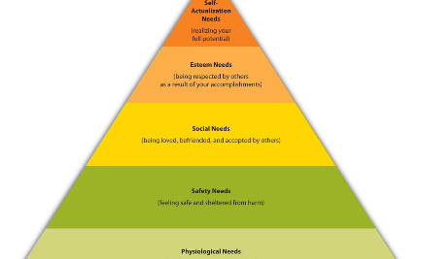

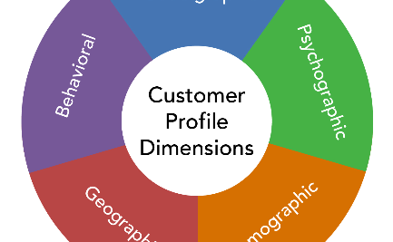
Consumer Insights and Engagement
Top customer preferences and tendencies
Loyal Customer Engagement Metrics
Target Demographics and Locations
Tracking how customers interact with the brand and identify any patterns in their purchasing behaviors. Using this data to build a loyalty program or create personalized customer experiences.
Identifying patterns or key metrics within your most loyal customers. Using these insights to help shape your marketing approach and create targeted campaigns that will resonate with this group.
Understanding the regions and demographic profiles that your retail business targets. Using this data to target your marketing efforts to these specific groups.

Slide 7
Payments and Customer Purchase Behavior
1
Payment Trends
Tracking payment trends and identify patterns in payment options chosen by customers for Sales data.
Monitoring Abandoned Carts
2
Shows how often customers abandon their carts, and identify possible improvements in the checkout process.
3
Customer Purchase Behavior
Understand how often customers make purchases over time and identify trends or seasonality that can help us plan marketing promotions/campaigns.

Slide 8
Business Performance Metrics
Sales Over Time
Store Performance Metrics
Track how overall retail sales perform over time and identify key growth opportunities for product lines and regions.
Monitor different stores' overall performance and identify any patterns or opportunities for growth.
Revenue Metrics by Region
Marketing Metrics
Track regional retail revenue metrics and identify key regional growth opportunities.
Monitor marketing metrics such as email open and click-through rates, social media engagement, and promotional conversion rates.

